Slide 1
Chatbot & Dashboard LU JIANAN

Slide 2
Content
1. Introduction
2. Project Demo
3. Project Technical Complexity
4. Technical Requirement
5. Future Improvement

Slide 3
Introduction
Research Lab Team in ONECONNECT lack of UX/UI product for visualize and user experience on chatbot
By creating a chatbot UI prototype to help the team for automating service and research propose
Chatbot are capable to have text feature, image feature, button feature response.
Notes:
business to business (B2B) port community solution

Slide 4
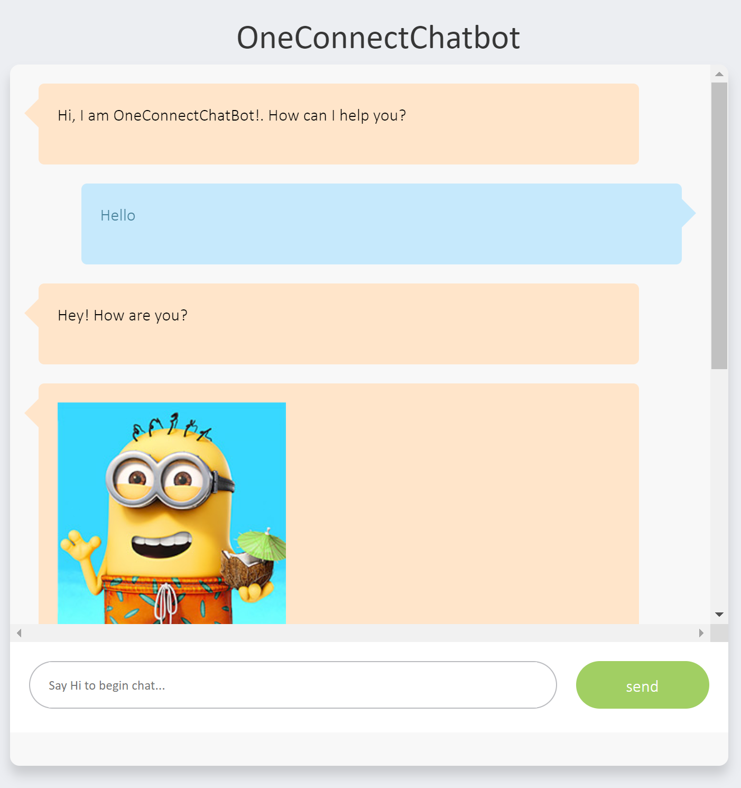
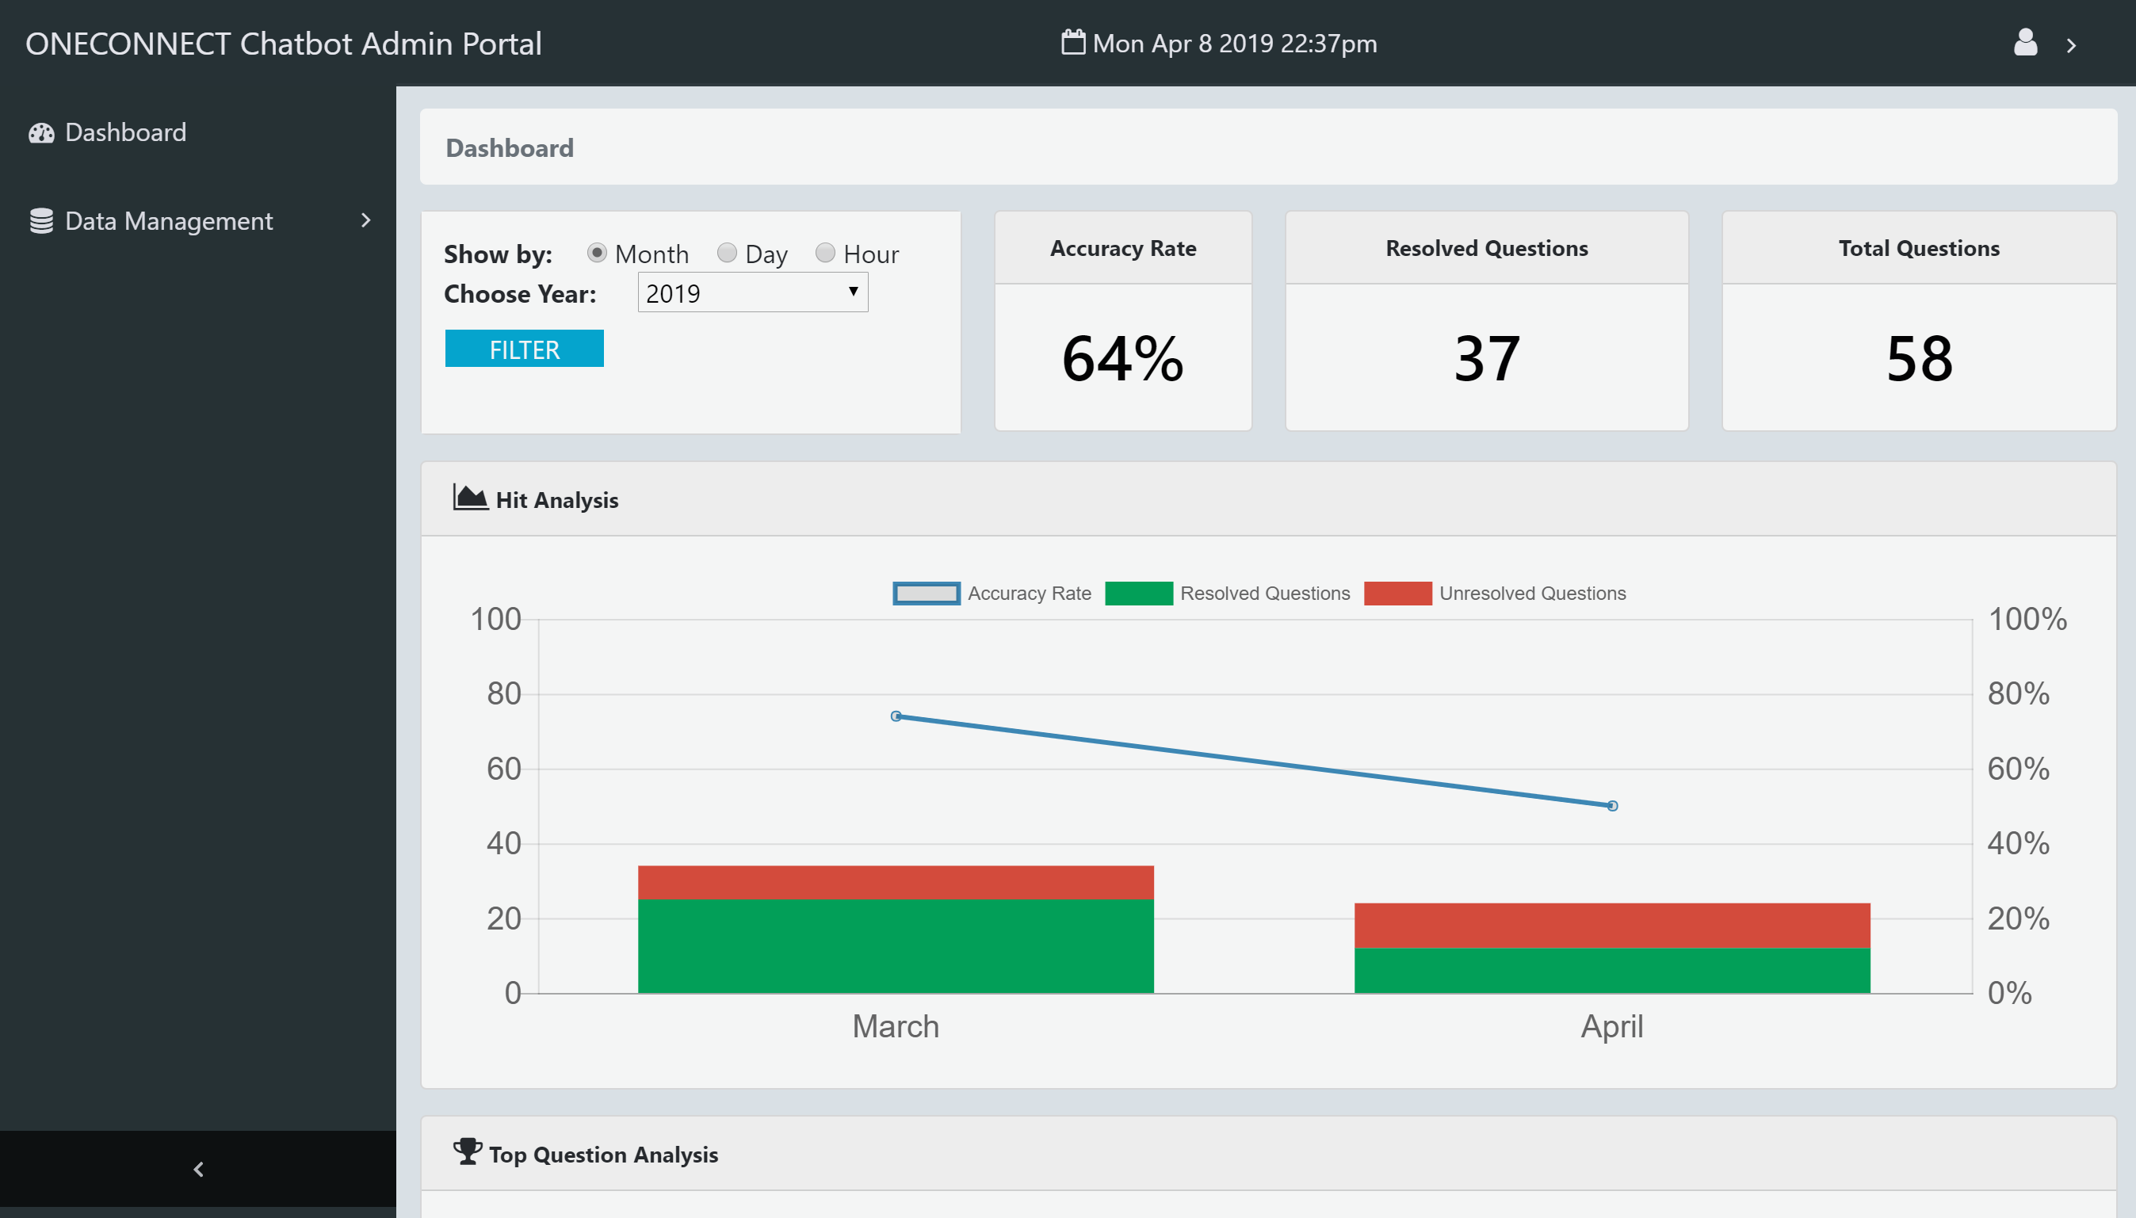
Demo
Notes:
business to business (B2B) port community solution

Slide 5
Technical Complexity

Slide 6
User Input Processing
User Input
Sentence comparison between user input & FAQs based vector proximity
(Handled by Rasa NLU[Spacy])
Similarity >= 90%?
Handled by Rasa Core Model
Yes
Return Answer
Notes:
business to business (B2B) port community solution

Slide 7
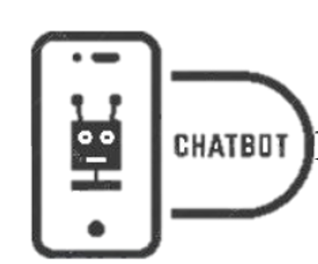
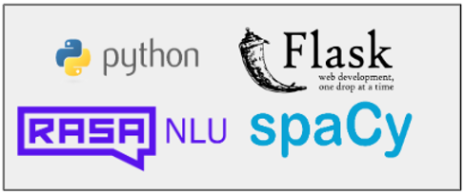
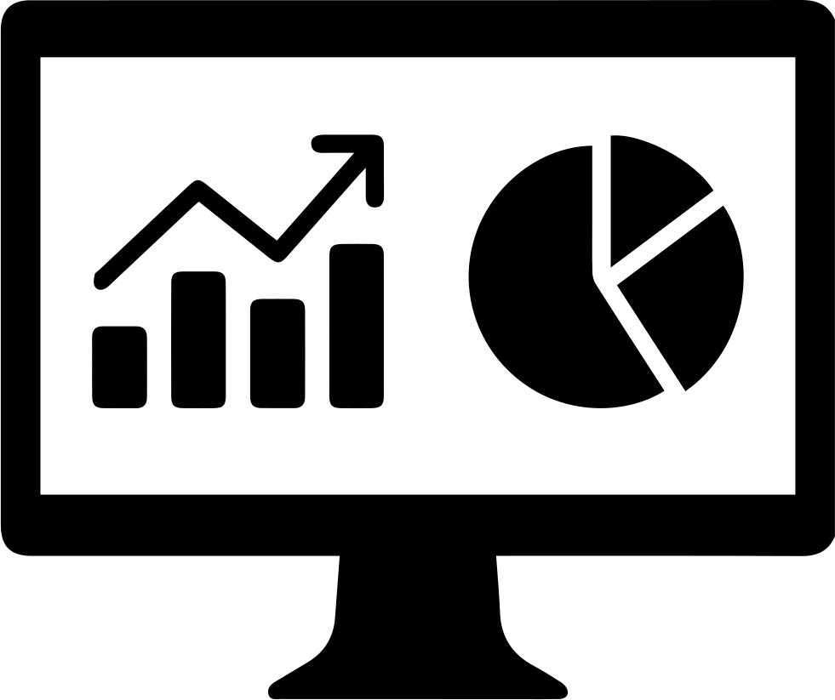
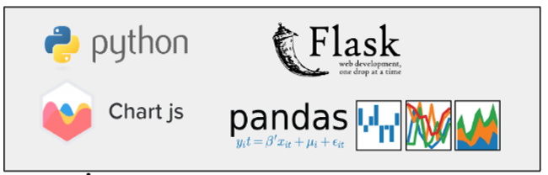
Architecture Diagram
Client Side : Frontend
Server Side : Backend + Database
User Input
Response
Chatbot Interface
Processed Data
Analysis Table
Faq Table
Faq_Category Table
User Table
Q & A
Server Side : Frontend
Processed Data
MySQL Database
Filtered Data
User Input
Filtered Data
Admin Dashboard Interface
Notes:
business to business (B2B) port community solution

Slide 8
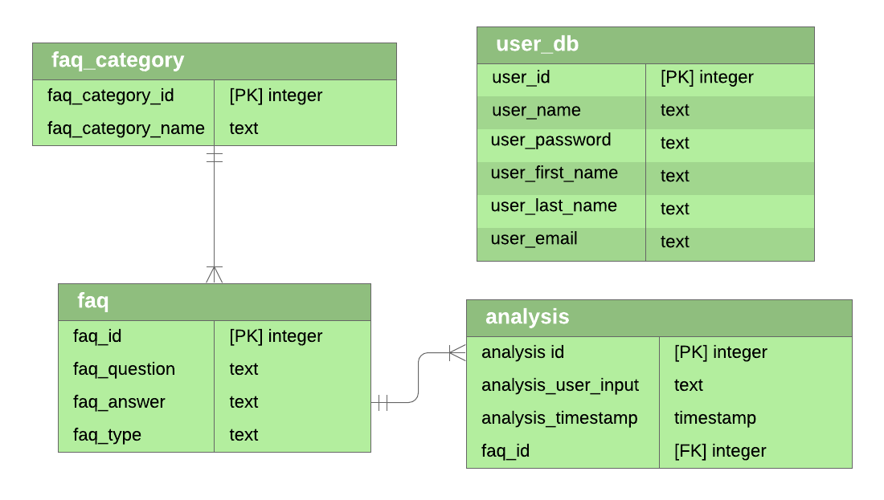
Database ER Diagram
Notes:
business to business (B2B) port community solution

Slide 9
Database ER Diagram Description
User Table:
Admin Account Information
Faq Table:
Storing FAQ’s Question and Answer.
FAQ Category Table:
Storing FAQ Category Information
Analysis Table:
Storing User Input Data for Admin side analysis purpose
Notes:
business to business (B2B) port community solution

Slide 10
Technical Requirement
Development Environment:
Windows (Limitation on use of NLP Model)
Linux
Development Language:
Client side: Angular 7
Server side: Python (Flask), Html, CSS, JavaScript , SQL
Development Tools:
Visual Studio Code, GitHub and MySQL Workbench etc.
Installation Guide
Readme.md
Notes:
business to business (B2B) port community solution

Slide 11
Future Improvement
NLP Model can be improved for higher similarity matching
Chatbot UI can be improved
Admin Dashboard can add more features in (Such as Announcement, Feedback, Notification etc.)
Notes:
business to business (B2B) port community solution

Slide 12
THANK YOU !

